Slide 1
Accessibility Testing with Screen Readers & More
Erissa Duvall

Slide 2

Disclaimer
I have gotten A LOT of experience from my professional roles, but I am not officially representing my current and/or former employers.
I discuss regulations and legal standards, but I am not in any way a lawyer, solicitor, or someone otherwise trained/licensed to give legal advice.
Erissa

Slide 3

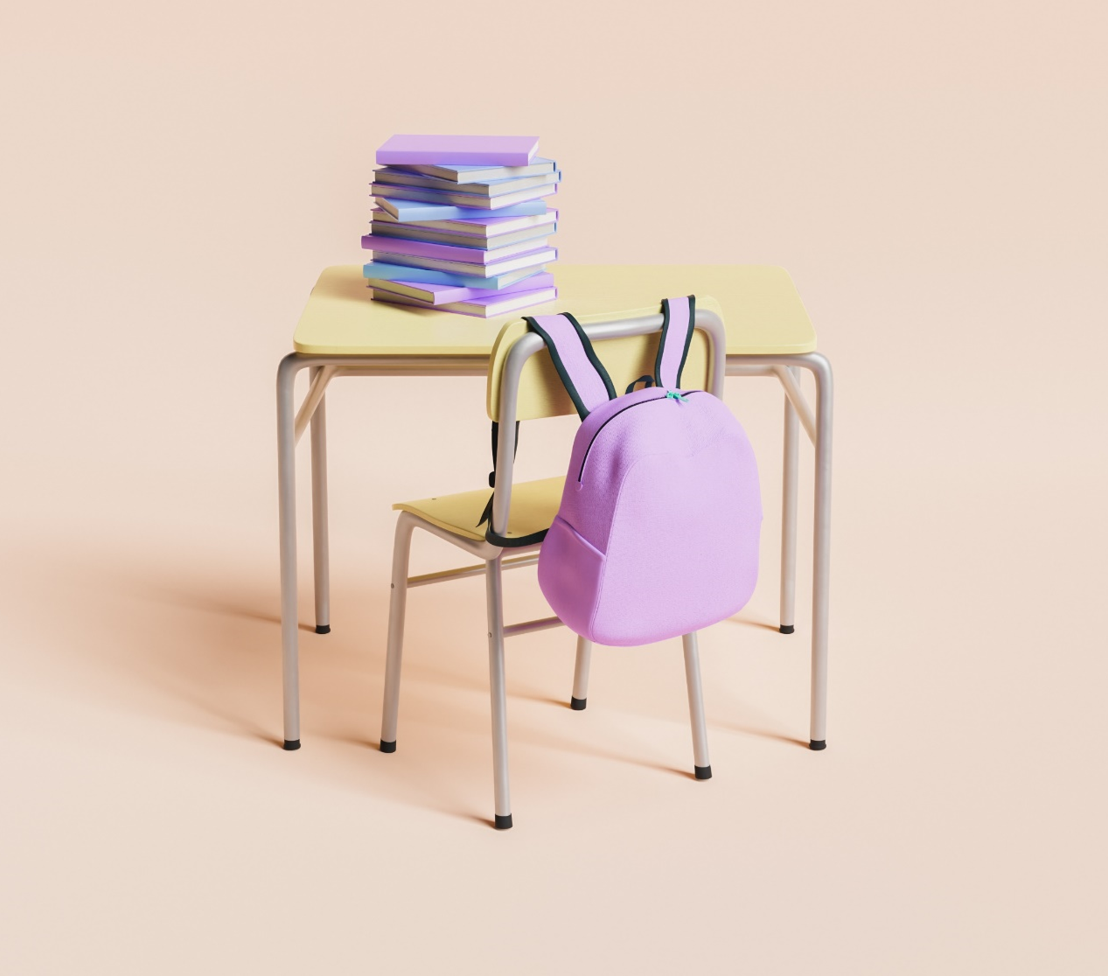
Agenda
Accessibility & Disability
Basics of Accessibility Testing
Why not just automate?
Testing Combinations
Known Issues
Tool Examples
Demo Time
Resources
Erissa

Slide 4
Accessibility & Disability
Quick Summary
Erissa

Slide 5
What are we looking for?
Can users perceive, operate, and understand the content/functionality with or without the aid of assistive technologies?
Erissa
Notes:
To that end we are looking at how accurately, clearly, and consistently the content is communicated.
Some of what we are looking at, include:
Structure
Headings
landmark regions (header, main, footer, nav, form, etc.)
Relationships
heading to its content
heading to other headings (not having to headings as H2s even though one is meant to be under the other)
label to its input
Lists (ordered vs unordered)
Function
links vs buttons
radio vs checkbox
special formatting requirements for a field to validate
how to access/expand a widget
conflict with existing common user key shortcuts
Information
Not just using color
Accessible labeling
Proper color contrast
CSS images not the only way of conveying information

Slide 6
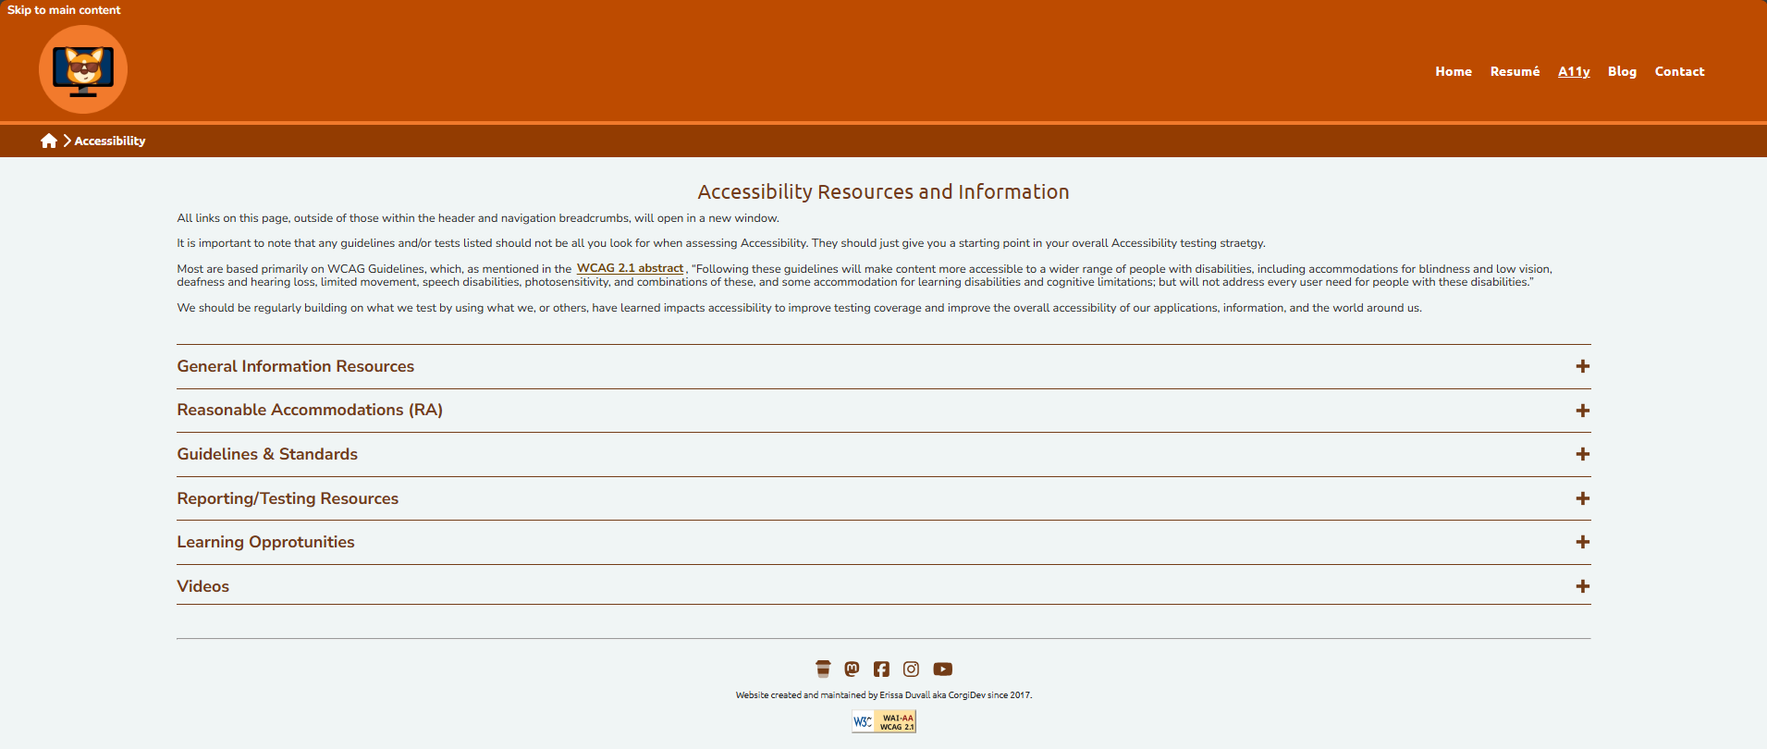
What are we looking for? – Example 1
Erissa
Notes:
Https://corgidev.com/a11y.html

Slide 7
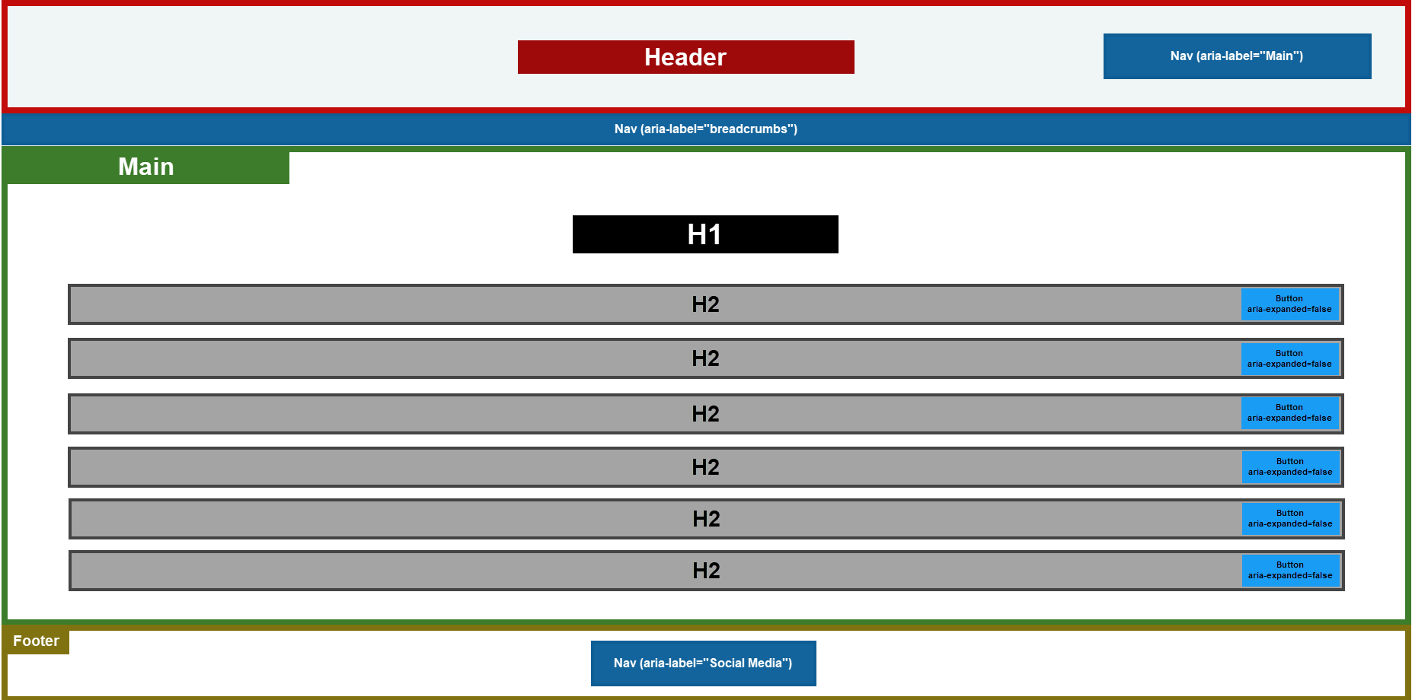
What are we looking for? – Example 2
Erissa
Notes:
Header
Nav: aria-label=“Main”
Nav: aria-label=“Breadcrumbs”
Main
H1
H2
Button with an aria-expanded attribute
H2
Button with an aria-expanded attribute
H2
Button with an aria-expanded attribute
H2
Button with an aria-expanded attribute
H2
Button with an aria-expanded attribute
H2
Button with an aria-expanded attribute
Footer
Nav: aria-label=“Social Media”

Slide 8
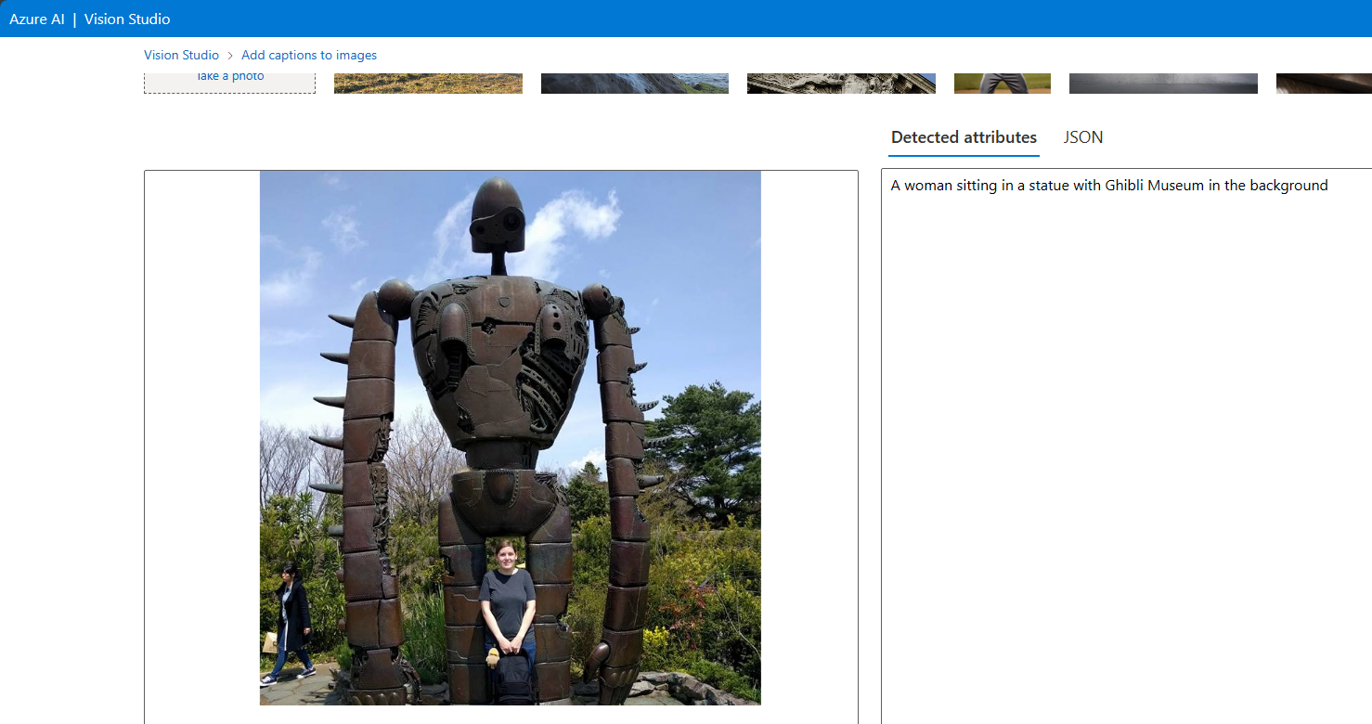
Why not just automate?
Erissa
Notes:
Azure Vision Studio - https://portal.vision.cognitive.azure.com/demo/image-captioning
Image of a dog next to a sign saying they beat cancer was found: https://images.foxtv.com/static.foxla.com/www.foxla.com/content/uploads/2023/05/1280/720/dog-beats-cancer-fox-news.jpg?ve=1&tl=1

Slide 9
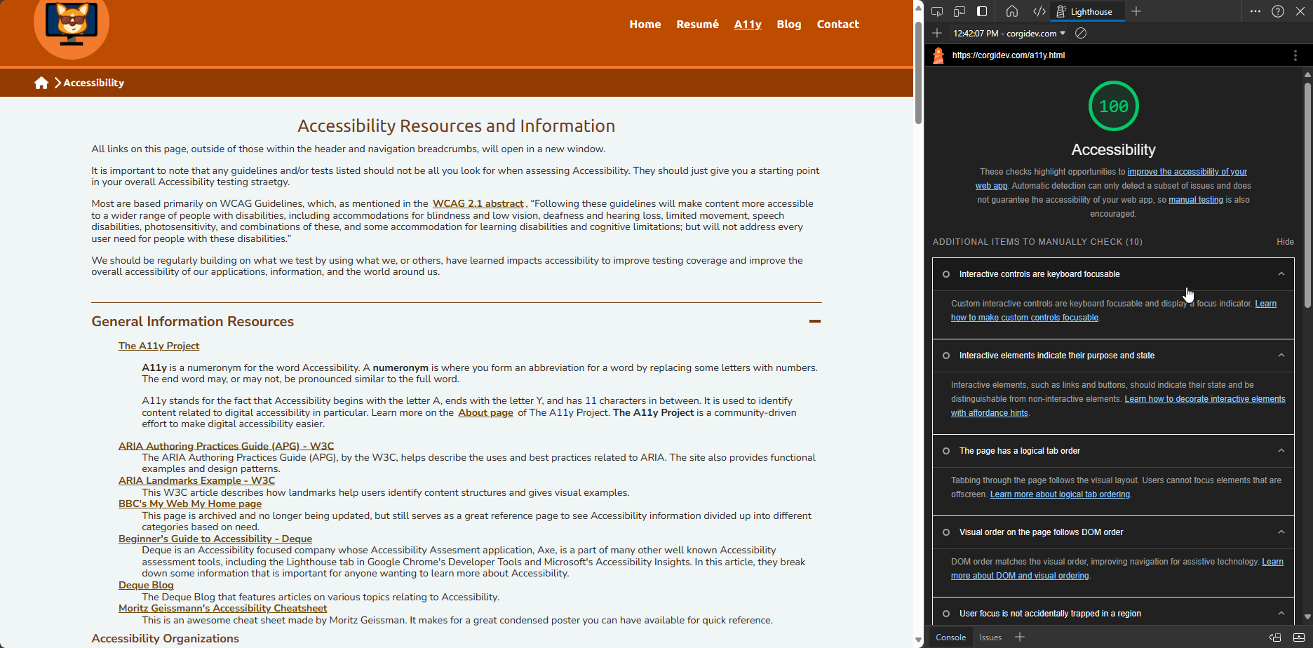
Why not just automate? - Continued
Erissa

Slide 10
Testing Combinations
Operating System | Platforms | Browsers | Screen Readers
Windows | Desktop | Edge Chrome Firefox | Narrator NVDA JAWS
MacOS | Desktop | Safari Chrome Firefox | VoiceOver
Android | Mobile | Chrome Firefox | TalkBack
iOS | Mobile | Safari Chrome Firefox | VoiceOver
Erissa

Slide 11
Known Issues
Example Known Issues
Android: TalkBack doesn’t always read required attributes even when you use aria-required.
MacOS & iOS: When using VoiceOver & Safari, unordered lists that have had their styling removed won’t be read as lists consistently.
Issue Trackers
https://issuetracker.google.com/
https://issues.chromium.org/
https://bugs.webkit.org/
https://github.com/nvaccess/nvda/issues
Erissa

Slide 12
Tool Examples
Bookmarklets
Browser Extensions
Desktop Applications
Screen Readers
Other
Landmarks
Headings
Lists
Lang
Text Spacing
ANDI
Target Size
Accessibility Insights
Axe DevTools
WAVE
Web Developer
Color Contrast Analyser (CCA)
PDF Accessibility Checker (PAC)
Photosensitive Epilepsy Analysis Tool (PEAT)
JAWS
NVDA
VoiceOver
Narrator
TalkBack
Axe Linter
ZoomText
Fusion
Dragon
Erissa

Slide 13
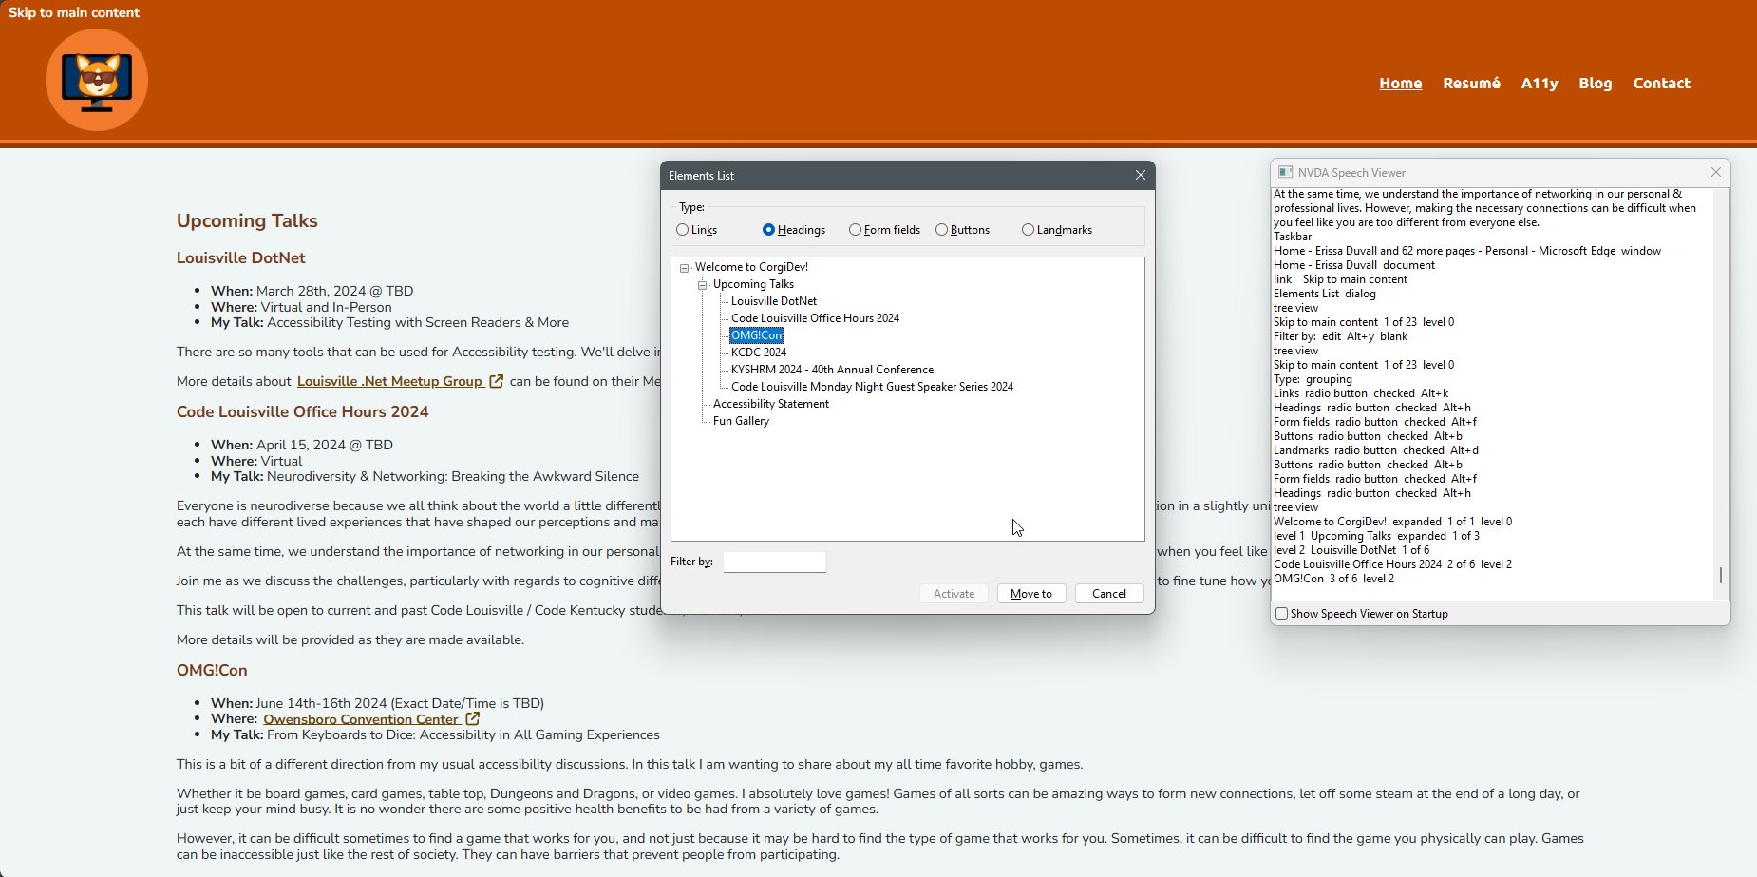
Demo Time
Screen reader audio may not be audible for people watching virtually but will be visible.
Interesting Note: If you ever use operating system color filter settings, note that those are often not visible to people who may be watching you streaming.
Erissa

Slide 14
Thank you & QA
Erissa Duvall
www.corgidev.com
https://www.linkedin.com/in/corgidev
Erissa

